Slide 1
Notes:
The Synod Logo
A large, majestic tree, full of wisdom and light, reaches for the sky. A sign of deep vitality and hope which expresses the cross of Christ. It carries the Eucharist, which shines like the sun. The horizontal branches, opened like hands or wings, suggest, at the same time, the Holy Spirit.
The people of God are not static: they are on the move, in direct reference to the etymology of the word synod, which means "walking together". The people are united by the same common dynamic that this Tree of Life breathes into them, from which they begin their walk.
These 15 silhouettes sum up our entire humanity in its diversity of life situations of generations and origins. This aspect is reinforced by the multiplicity of bright colours which are themselves signs of joy. There is no hierarchy between these people who are all on the same footing: young, old, men, women, teenagers, children, lay people, religious, parents, couples, singles; the bishop and the nun are not in front of them, but among them. Quite naturally, children and then adolescents open their walk, in reference to these words of Jesus in the Gospel: " I praise you, Father, Lord of heaven and earth, because you have hidden these things from the wise and learned and revealed them to little children”. (Mt 11:25)
The horizontal baseline: "For a synodal Church: communion, participation and mission” runs from left to right in the direction of this march, underlining and strengthening it, to end with the title "Synod 2021 - 2023", the high point that synthesizes the whole.

Slide 3
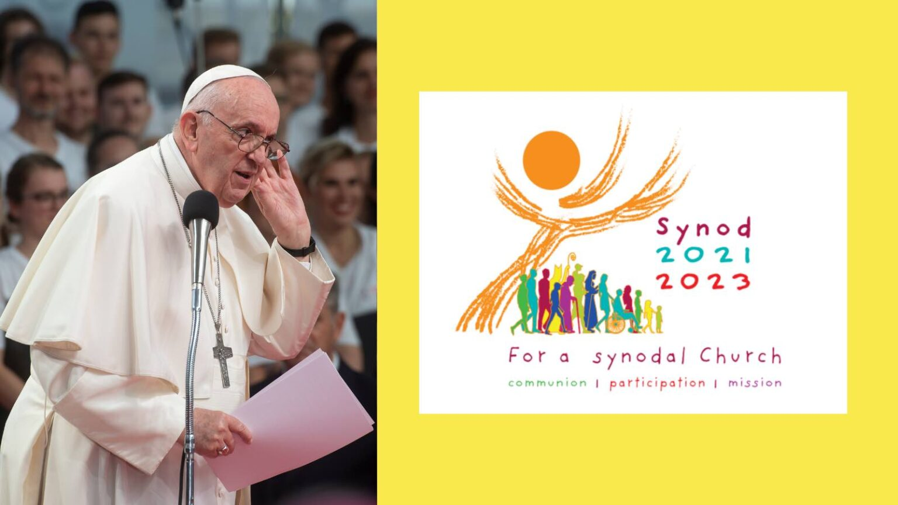
Notes:
The speech in commemoration of the 50th anniversary of the institution of the Synod (17 October 2015) completely opened the scene for “synodality as a constitutive element of the church.” One of the most quoted phrases of Pope Francis taken from that speech is as follows. “It is precisely this path of synodality which God expects of the Church in the third millennium.” He also described the synodal Church as a ‘Church of listening,’ in which each of us learns from one another, the People of God, the College of Bishops, and the Bishop of Rome. In fact, the synodal process is defined by the idea that “the Synod of Bishops is the point of convergence of this listening process conducted at every level of the Church’s life.” This means listening to the local church, the People of God. Listening at the intermediate levels of synodality, especially the Episcopal Conferences, where the bishops exercise their function of discernment, and finally at the level of the Universal Church, in the Assembly of the Synod of Bishops. Episcopalis communio does nothing other than approve these ideas.

Slide 4
John of Damascus
According to John of Damascus, the virtue of discernment "is greater than any other virtue; and is the queen and crown of all the virtues"
Notes:
Discernment it is a kind of wisdom that comes from insight as much as from learned experience and knowledge.
In the Christian faith, it comes from the Holy Spirit, and is a way of having insight in determining the true nature of a situation, person, or thing.

Slide 5
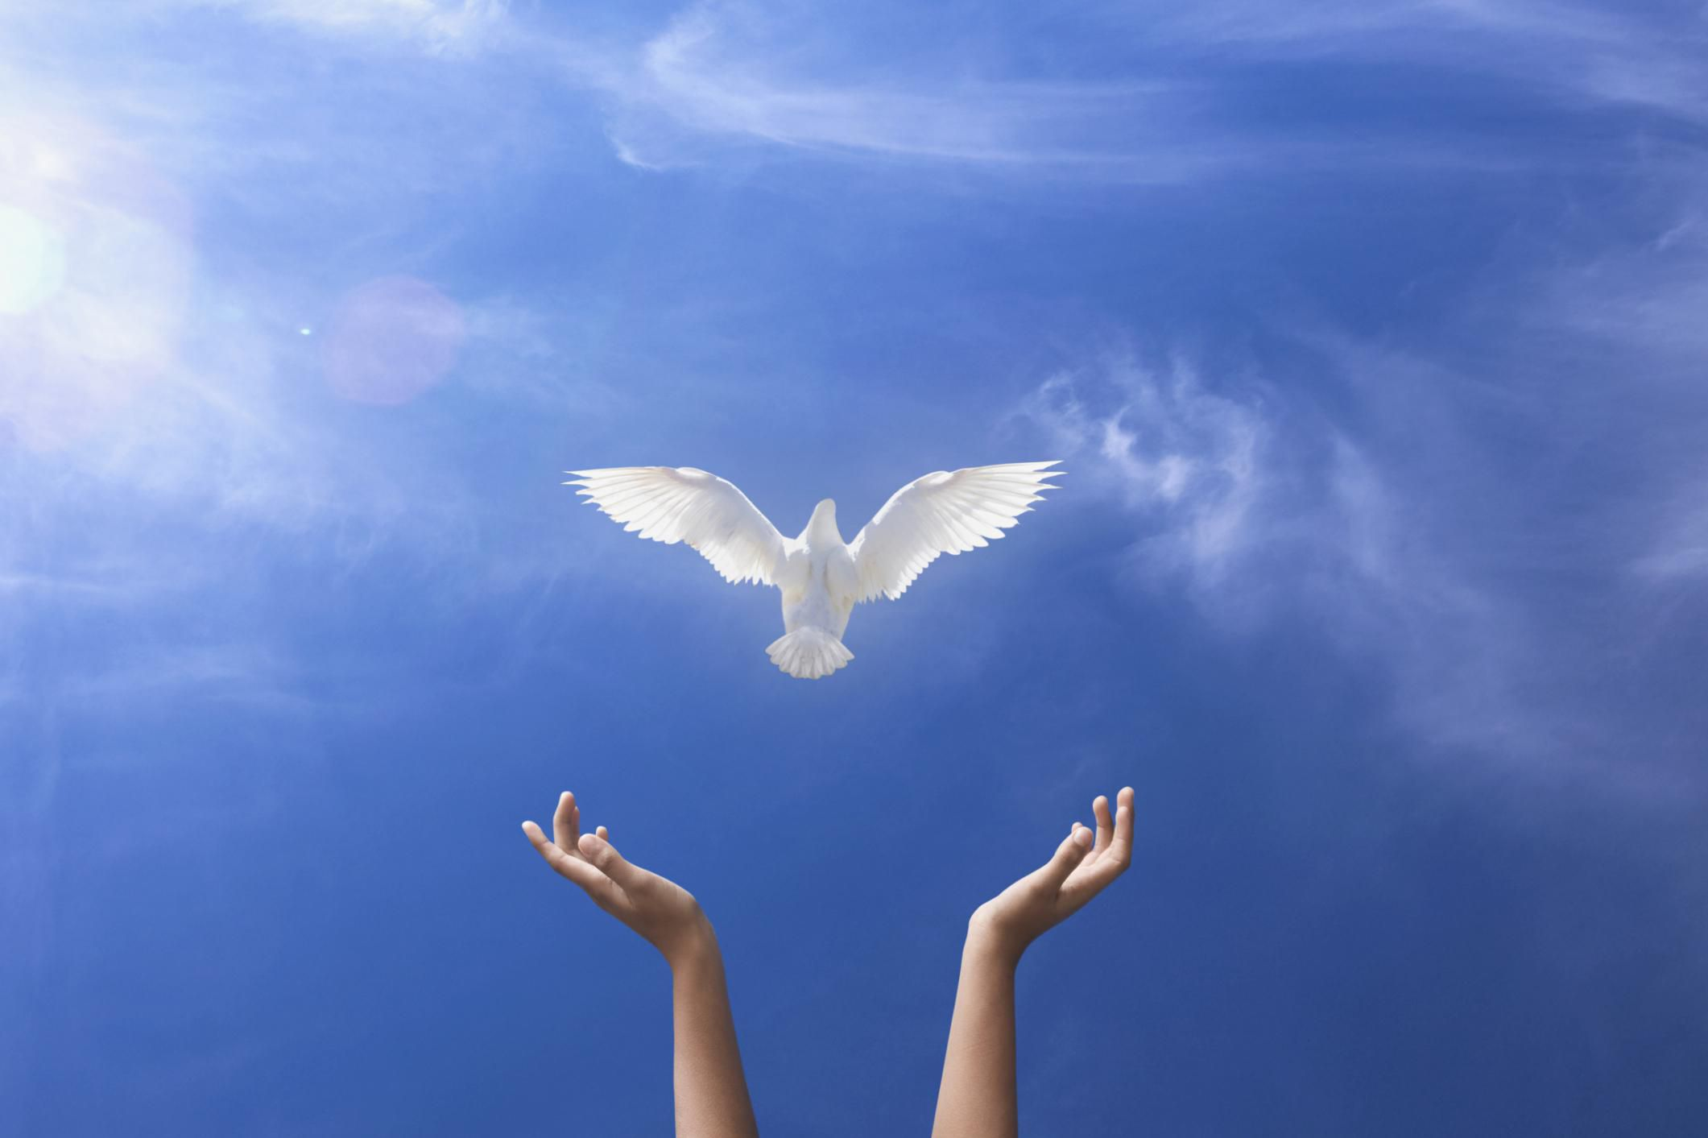
Notes:
I lift up my eyes to the hills.
From where does my help come?
My help comes from the Lord,
who made heaven and earth. (Psalm 121:1)
The Protagonist of this Synod is none other than the Holy Spirit.
It is to Him we lift up our eyes, open up our hearts and minds.
When the Spirit of truth comes, he will guide you into all the truth, for he will not speak on his own authority, but whatever he hears he will speak, and he will declare to you the things that are to come. He will glorify me, for he will take what is mine and declare it to you. All that the Father has is mine; therefore I said that he will take what is mine and declare it to you. (John 16:13ff)
It is through Him we have the ‘mind of Christ’ as Paul would attest to the church in Corinth:
as it is written,
“What no eye has seen, nor ear heard,
nor the heart of man imagined,
what God has prepared for those who love him”—
these things God has revealed to us through the Spirit. For the Spirit searches everything, even the depths of God. For who knows a person's thoughts except the spirit of that person, which is in him? So also no one comprehends the thoughts of God except the Spirit of God. (1 Cor 2:9:11)

Slide 6
Praying In the Light of the Scriptures
Notes:
Ignorance of the Scriptures is ignorance of Christ, St Jerome

Slide 7
Listening to Each Other
Notes:
Of the many occasions the disciples spoke privately with Jesus:
Luke 5:1 “On one occasion, while the crowd was pressing in on him to hear the word of God, he was standing by the lake of Gennesaret”
Mark 4:10 “And when he was alone, those around him with the twelve asked him about the parables.” The Sower and the Seed.
Mark 9: 28 “And when he had entered the house, his disciples asked him privately, “Why could we not cast it out?” Deliverance of boy from a demon
Mark 10:10 “And in the house the disciples asked him again about this matter.” The issue of divorce.

Slide 8
10 Foci
For our Contemplative Dialogue
What is my dream for the Church so that it can become more outward looking, more missionary, especially towards those on the margins?
How is God speaking to us through voices we sometimes ignore? What space is there for the voice of minorities, especially people who experience poverty, marginalization, or social exclusion?
What enables or hinders speaking up courageously, candidly, and responsibly in our local Church and in society?
How do prayer and liturgical celebrations actually inspire and guide our common life and mission in our community?

Slide 9
What hinders the baptised from being active in mission? How does the community support its members who serve society in various ways (social and political involvement, scientific research, education, promoting social justice, protecting human rights, caring for the environment, etc.)?
How are divergences of vision, or conflicts and difficulties addressed? What particular issues in the Church and society do we need to pay more attention to? How does the Church dialogue with and learn from other sectors of society: the spheres of politics, economics, culture, civil society, and people who live in poverty?
To what extent do we share our journey with members of other Christian traditions and denominations? What fruits have we drawn from walking together?

Slide 10
How is authority or governance exercised within our local Church? How are teamwork and co-responsibility put into practice? How are evaluations conducted and by whom? How are lay ministries and the responsibility of lay people promoted?
Is there freedom to exercise our particular ministry in the Church and participate in this common work of discernment and decision-making?
What additional formation do I need to be a missionary disciple? What tools are necessary for the Church to be truly synodal, listening and journeying together?

Slide 11
Matthew 14:13-21
Then he broke the loaves and gave them to the disciples, and the disciples gave them to the crowds. And they all ate and were satisfied. And they took up twelve baskets full of the broken pieces left over. And those who ate were about five thousand men, besides women and children.
Notes:
The symbolism of the disciples gathering the scraps left over is not to be lost on us.
The fruit of our labour is the daily bread borne of the Word of God.
Unlike the manna in the desert it is not diminished by decay but rather incorruptible for it is Christ Himself.
It is all the more abundant so that the disciples may gather what is left over to feed those who are not of the 5000
But who nevertheless seek the sustenance of God’s presence in their lives.
The fruit of our contemplative dialogue that results in a consensus of thoughts, images, words, hearts and minds is what is to be collected
And recorded for our bishops. For it is to the college of bishops to discern what the Spirit is saying to the churches at this time.

